Slide 1
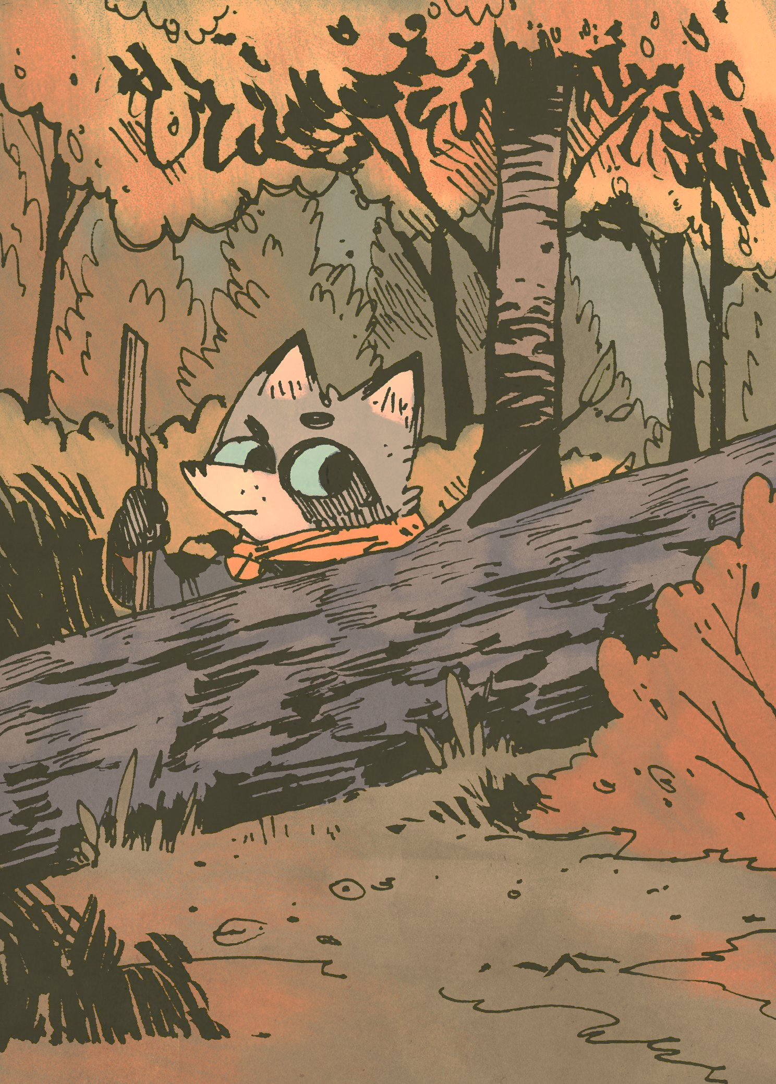

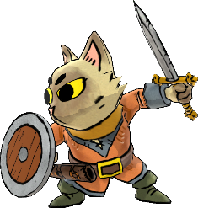
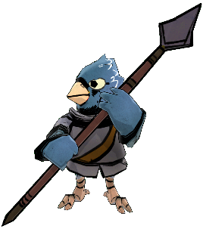
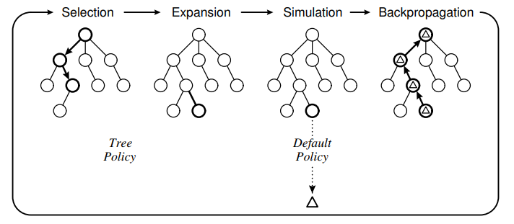
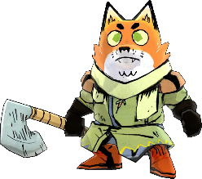
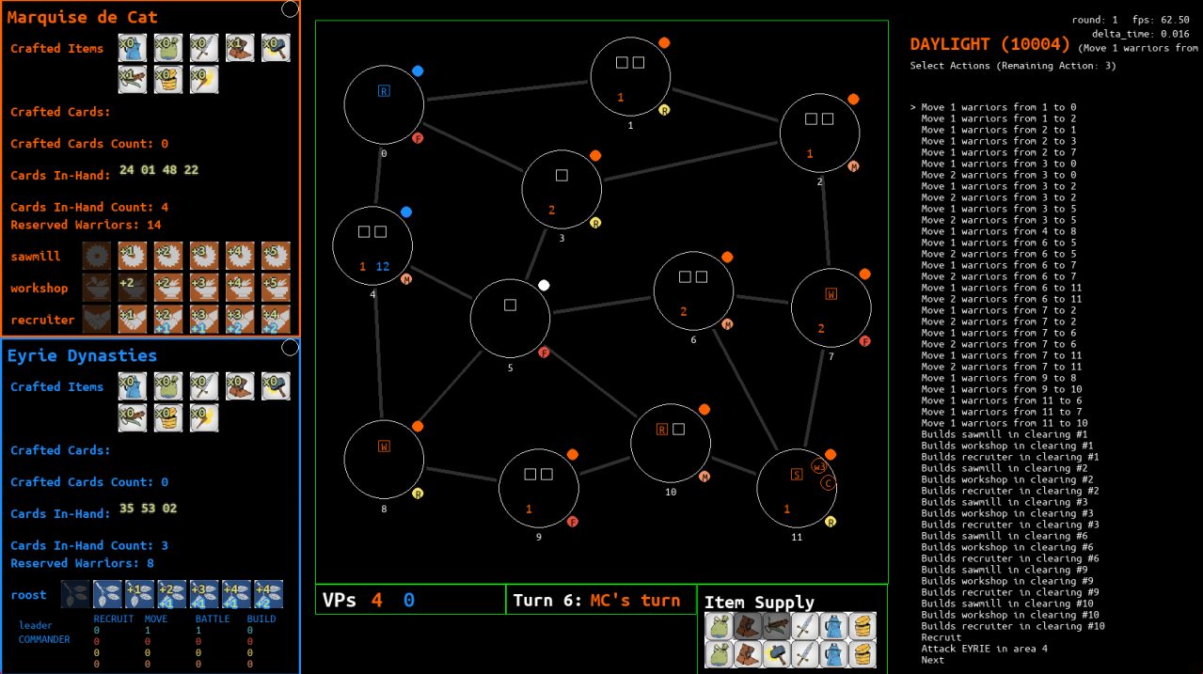
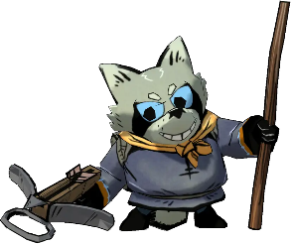
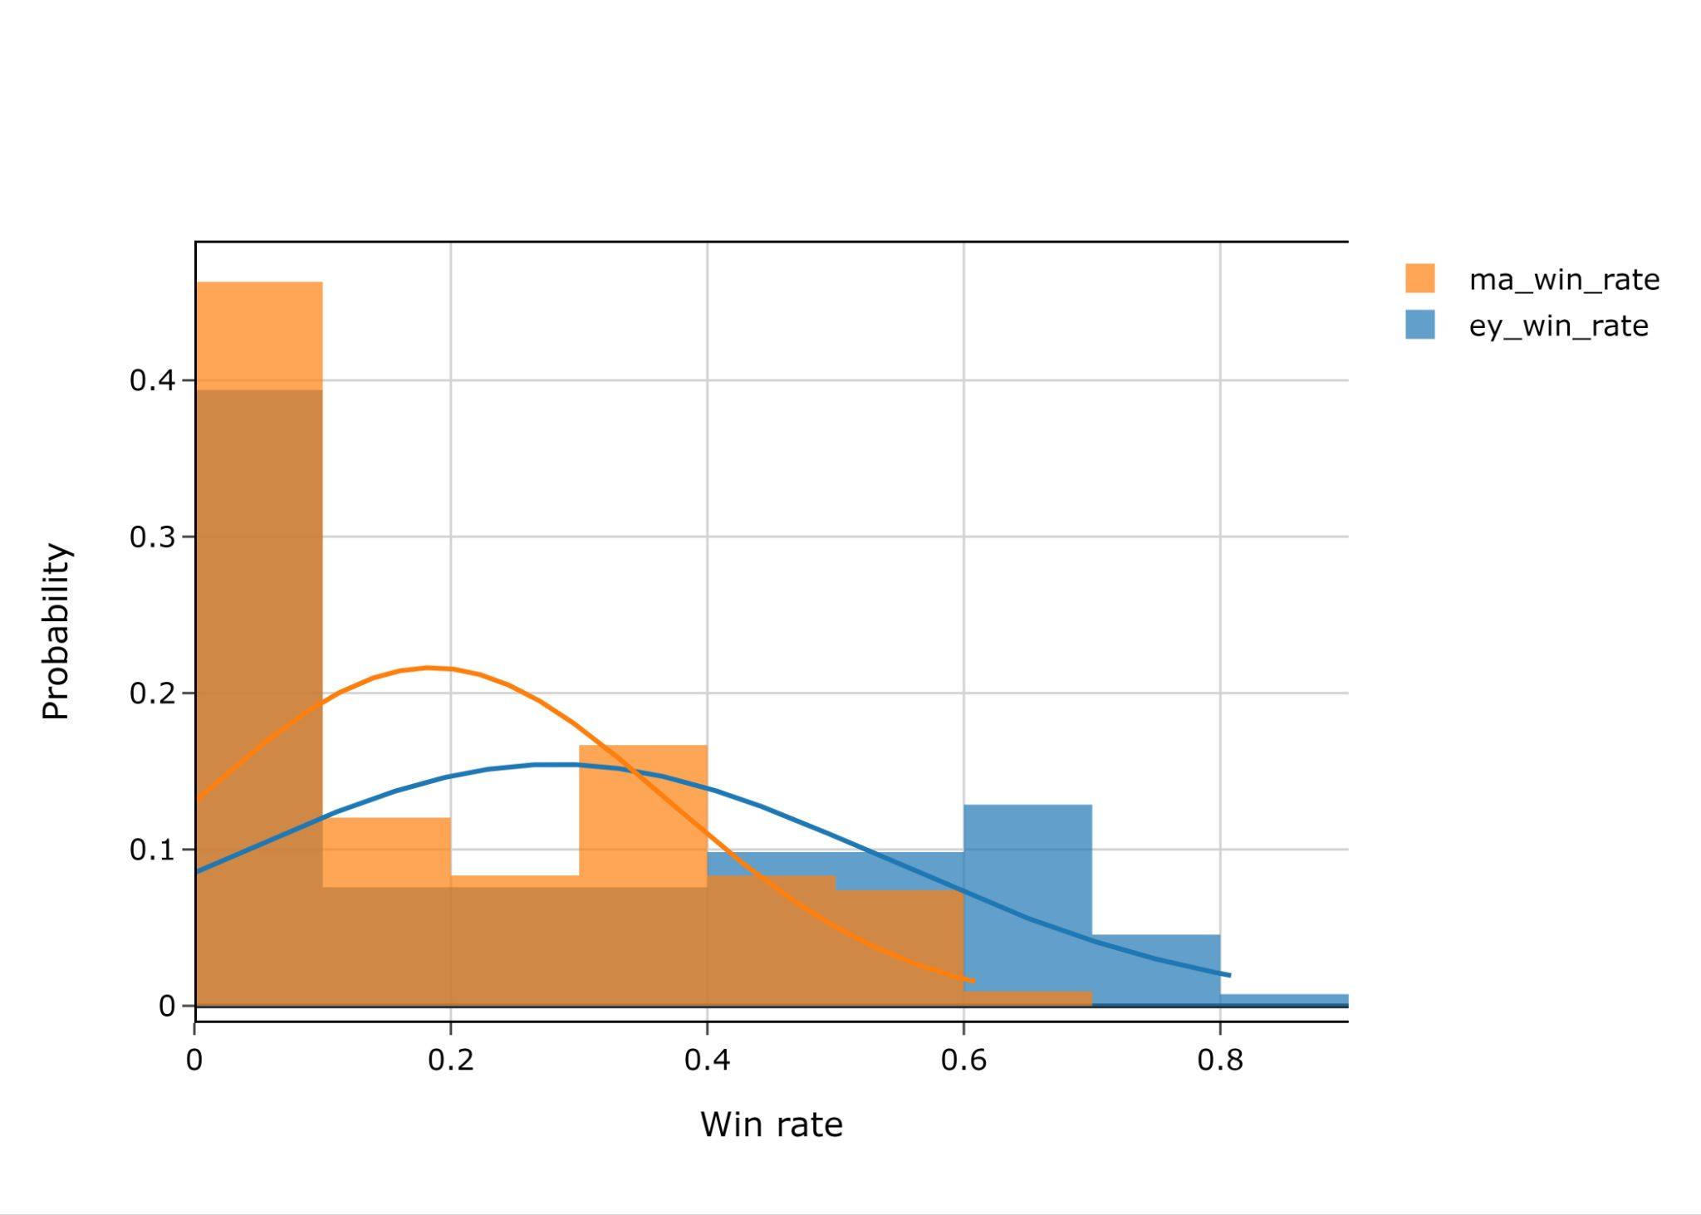
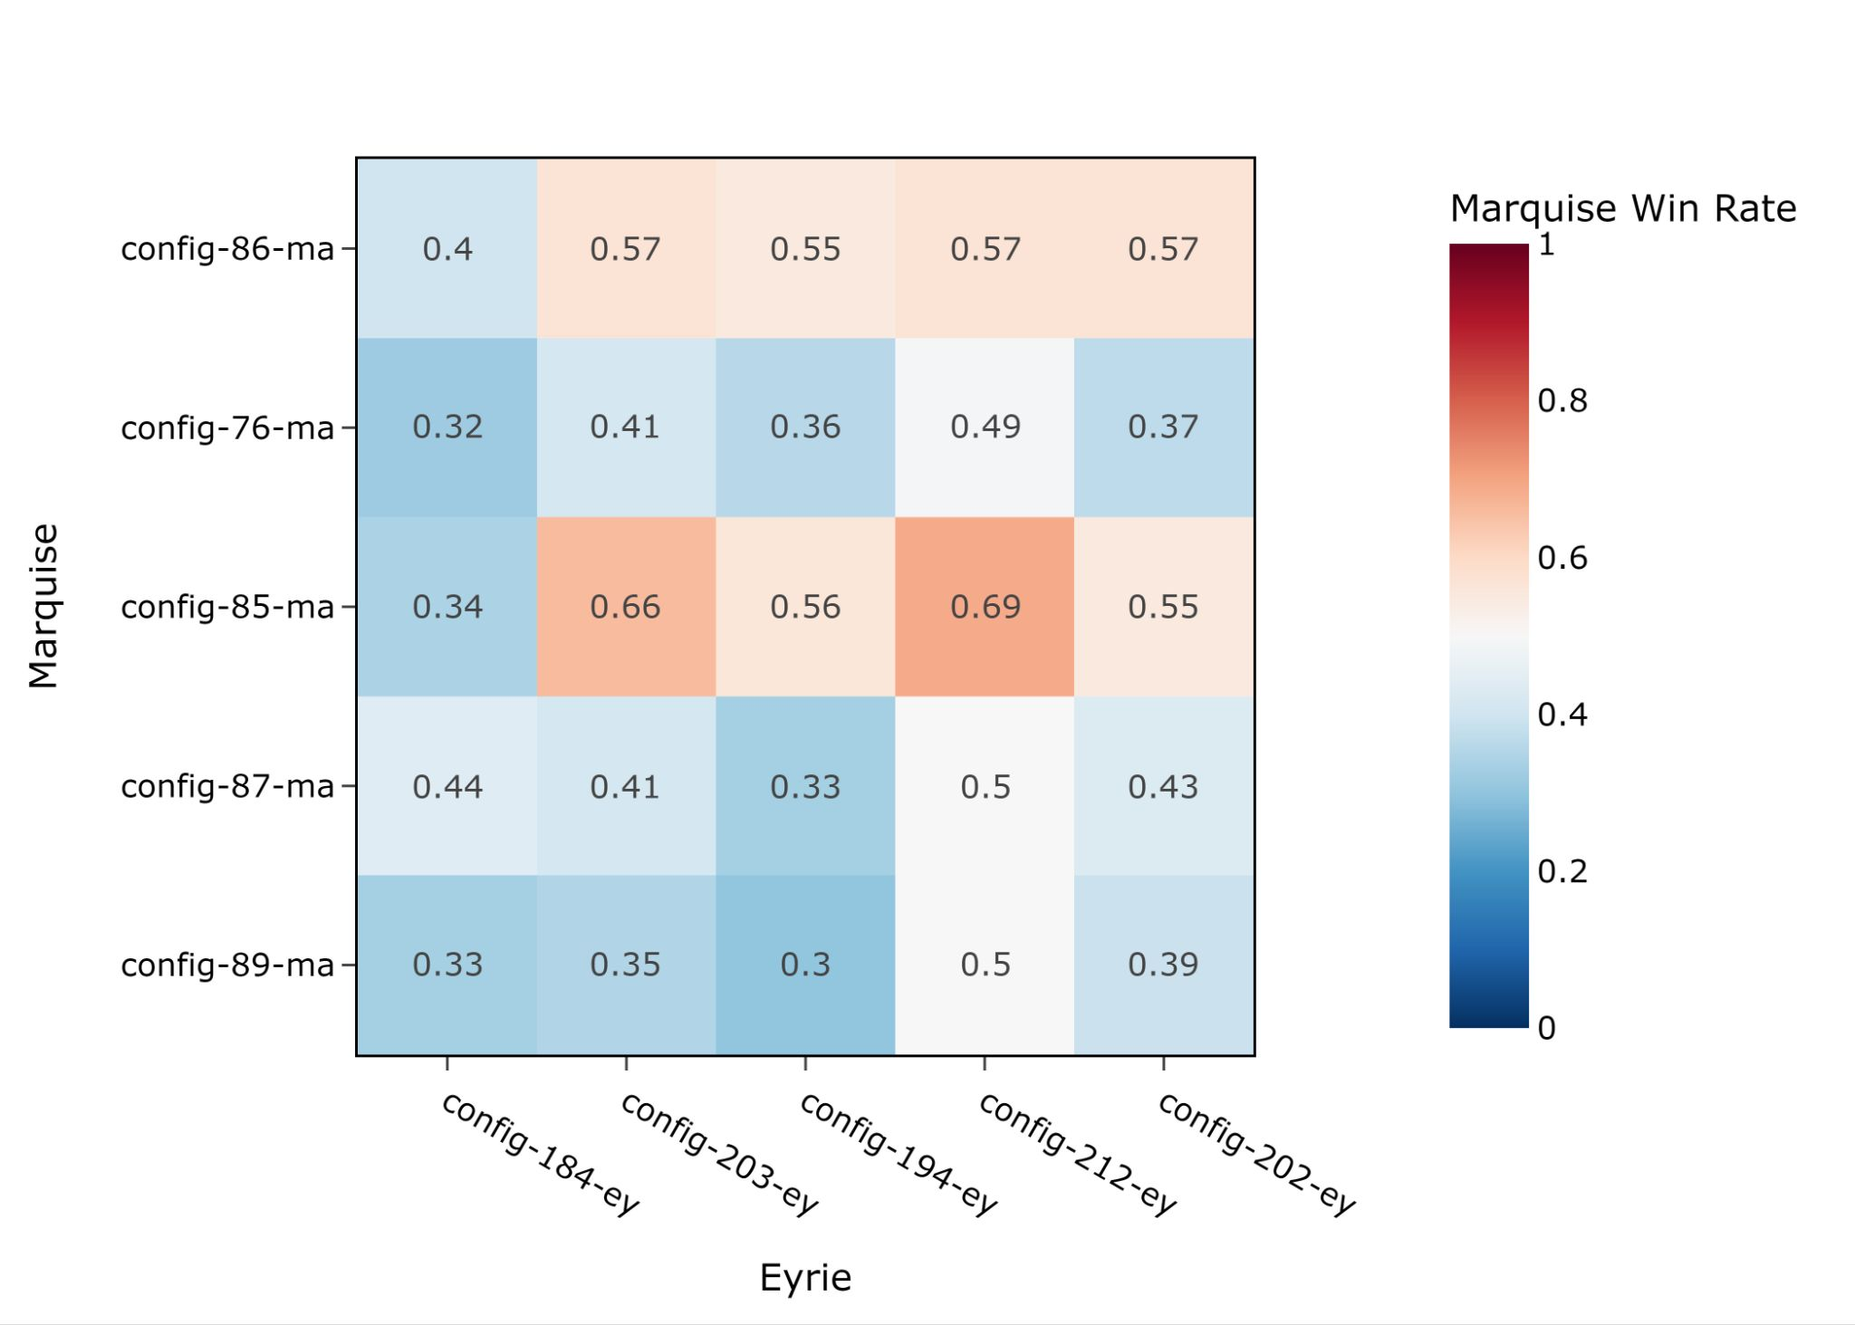



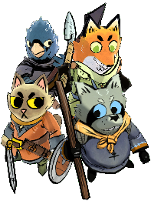


Project No. P003-2/66, Academic Year 2023
Artificial Intelligence for Root Board Game
Baangkok Vanijyananda, Pawaret Dilokwuttisit, Advisor: Kasemsit Teeyapan
Computer Engineering, Faculty of Engineering, Chiang Mai University
Introduction
A video game version of Root was released in 2020, but there are multiple reports by its players that the AIs make awful decisions that no humans would ever make in a similar situation. i.e., their AIs are bad. Especially Eyrie Dynasties’ AI.
Objectives
To create an artificial intelligence (AI) that can play the board game “Root”.
To find the best Monte Carlo Tree Search (MCTS) algorithm variant for playing the board game “Root” for each faction.
Methods
Create a minimal version of Root video game.
Implement the Open-Loop MCTS algorithm.
Create 108 MCTS variants for each faction
and have them fight against the other faction with the base MCTS variant → total 216 battles x 100 rounds.
Top 5 variants with highest win rate for each faction face a “Team-Round Robin” fight, i.e., they all fight each other.
The variant from each faction with highest average win rate will be the best variant for that faction.
Results
Phase 1 all variants’ win rate
Phase 2 top 5 Marquise VS top 5 Eyrie
Marquise faction is easier to play but has less potential to earn VPs
Eyrie faction is harder to play but has more potential to earn VPs
The best MCTS variant for Marquise de Cat achieved 56.0% average win rate with the following parameters:
reward-function: vp-difference
expand-count: 200 nodes
rollout-count: 1 rollout
time-limit: no-limit
action-count-limit: 100 actions
best-action-policy: max
The best MCTS variant for Eyrie Dynasties achieved 63.4% average win rate with the following parameters:
reward-function: vp-difference
expand-count: 200 nodes
rollout-count: 1 rollout
time-limit: no-limit
action-count-limit: 20 actions
best-action-policy: robust
Conclusion
Our AIs are intelligent! Our AIs’ average turns-to-win are 15.39 turns for Marquise and 13.68 turns for Eyrie. An average game of human versus human lasts 14 - 20 turns!
We have created two intelligent AIs using MCTS algorithm!
Computer Engineering, Faculty of Engineering, Chiang Mai University

